Slide 1
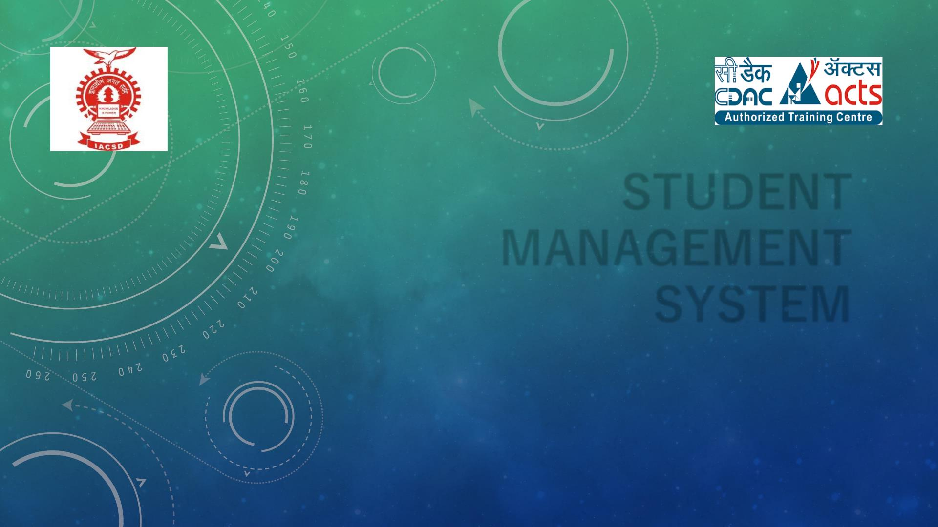
STUDENT
MANAGEMENT
SYSTEM
PRESENTED BY-
ANIKET BA N AYAT (219022)
ADITYA KOTKAR(219011)

Slide 2

POINTS TO BE DISCUSSED
1- INTRODUCTION
2-OBJECTIVE
3-SCREENSHOTS
4-SPECIFICATIONS
5-S/W and H/W requirement
6-CONCLUSION
7-FUTURE ENHANCEMENT

Slide 3

INTRODUCTION
• Portal is a web system that provides the function and features to authenticate and identify the users
and provide then with easy, intuitive, personalized and user-customizable web-interface for facilitating
access to information and services that are of primary relevance and interests to the users. Student
management Portal is nothing but a portal which thinks students as the main target & collect all the
information of the students to provides it to admin. This portal also provides so many useful services to
students at a single place & through a single interface but in customized form.

Slide 4

OBJECTIIVE
• The main purpose of this system, is to reduce the consumption of time during maintaining the records
of college. Separate divisions are providing to maintain the records of students. Our System also procure
an easy way not only to automate all functionalities of a college, but also to procure full functional
reports to top management of college with the finest of details about any phase of college.
In other words, our college portal has, following objectives:
➢ Simple database is maintained.
➢ Easy operations for the operator of the system. User interfaces are user accommodating and attractive;
it takes very less time for the operator to use the system.
➢The aim is to design a college website which implant update information of the college that should
improve expertness of college record management.

Slide 5

TECHNOLOGY USED
FRONTEND-HTML, CSS
BACKEND-ASP.NET, SPRINGBOOT API

Slide 6

UML DIAGRAM

Slide 7
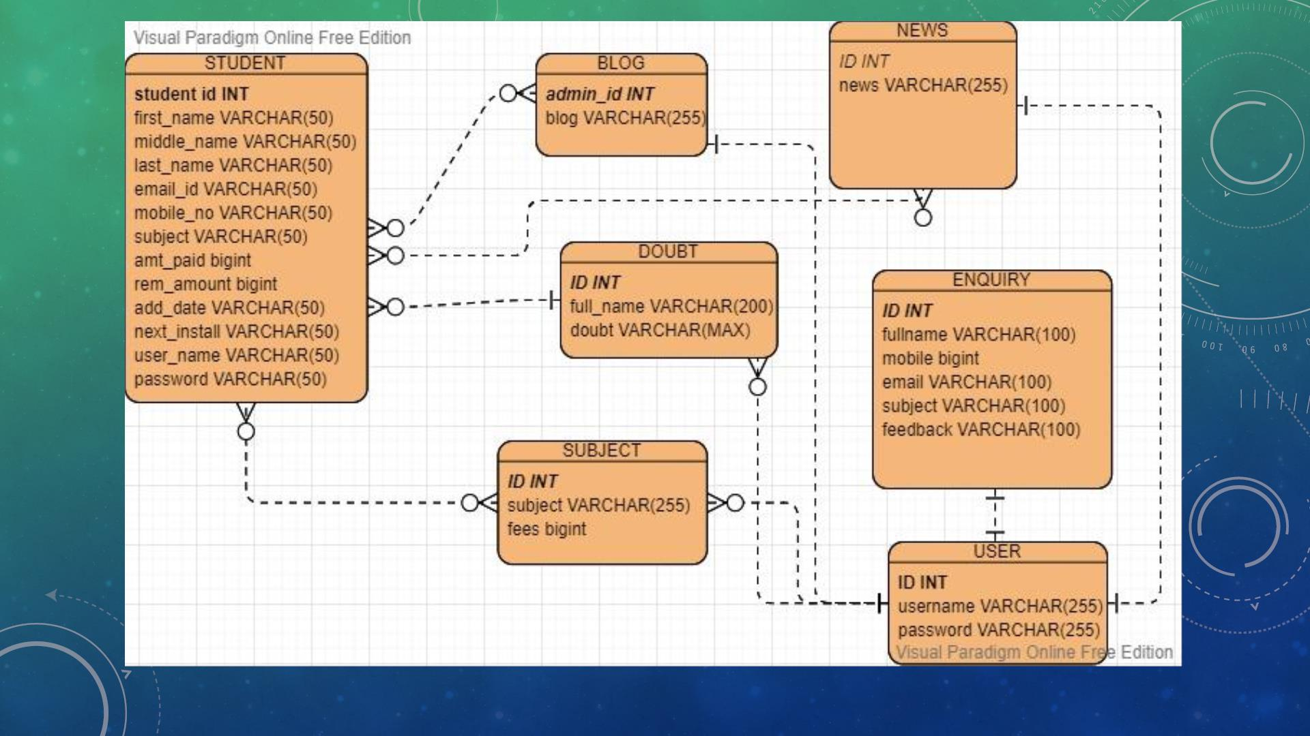

Slide 8
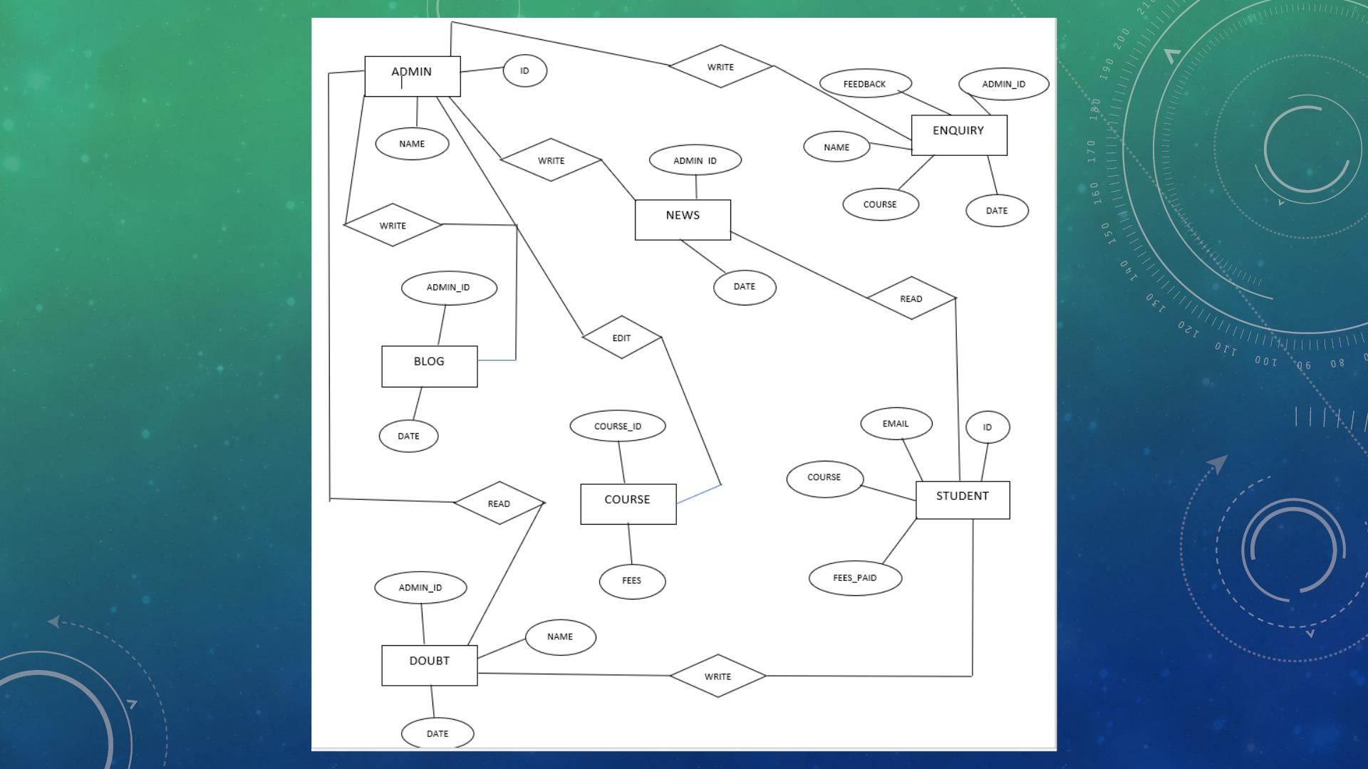

Slide 9
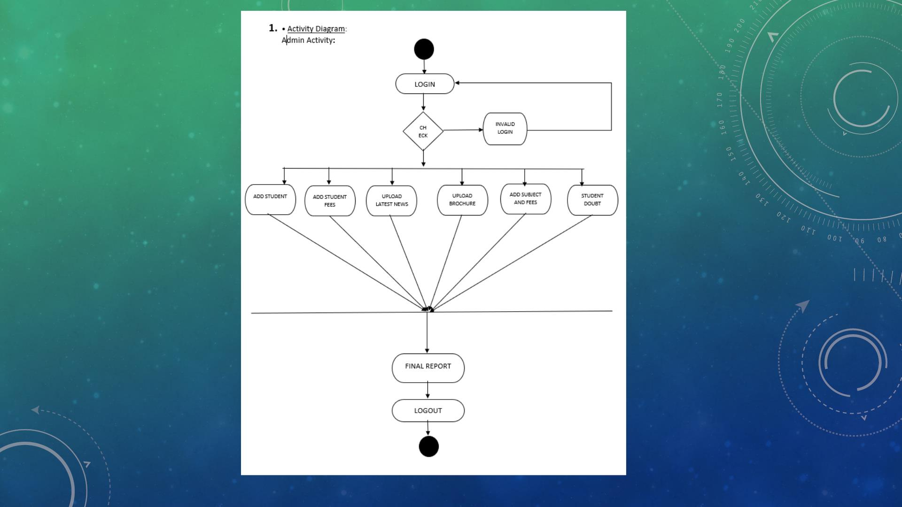

Slide 10
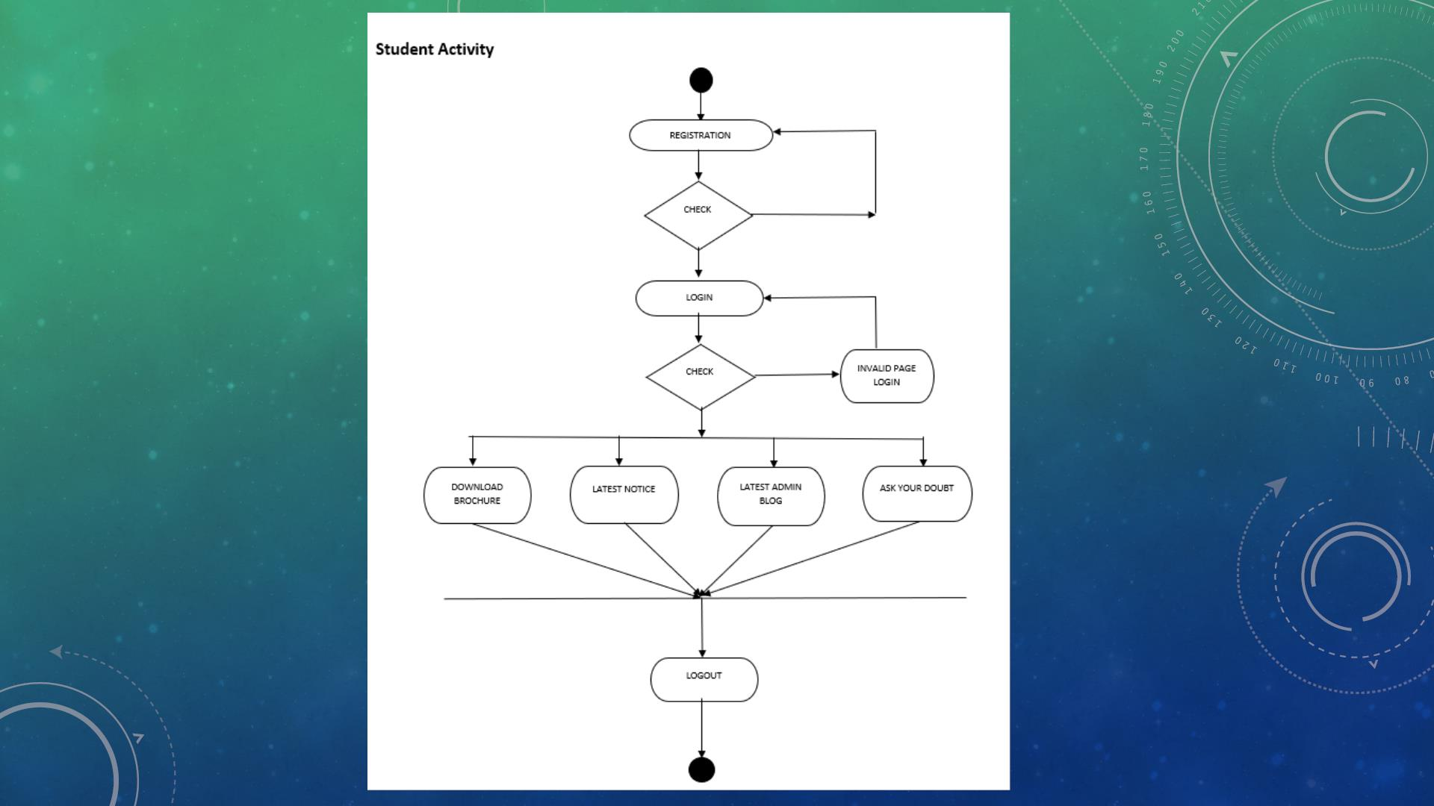

Slide 11
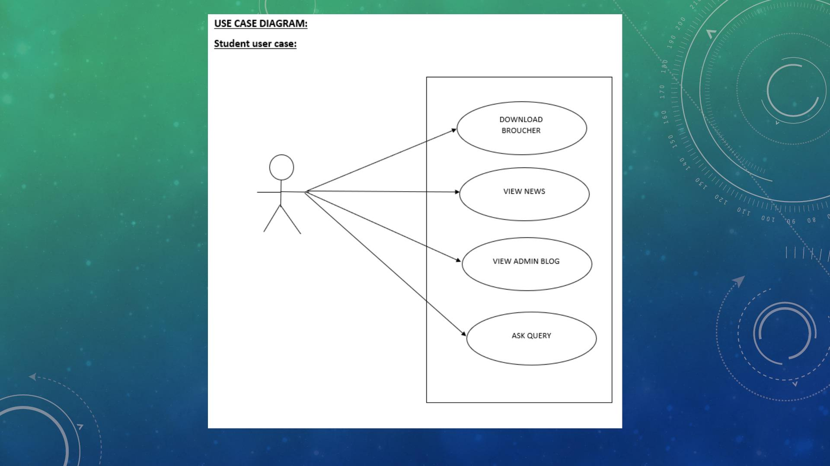

Slide 12
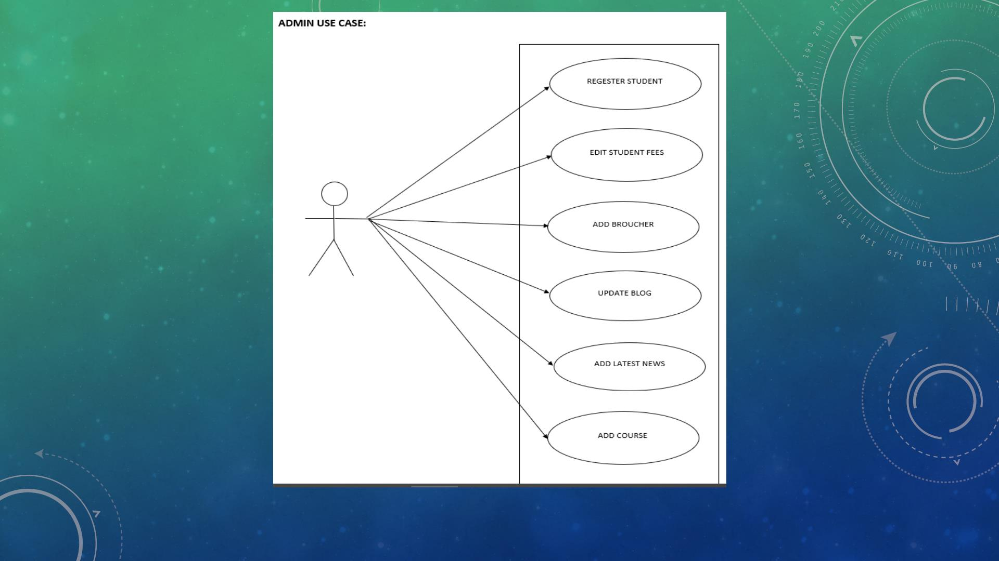

Slide 13
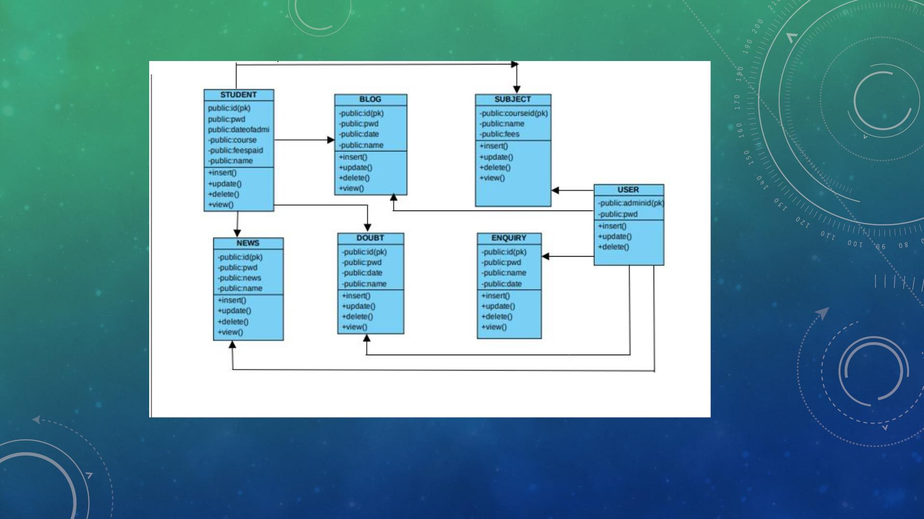

Slide 14
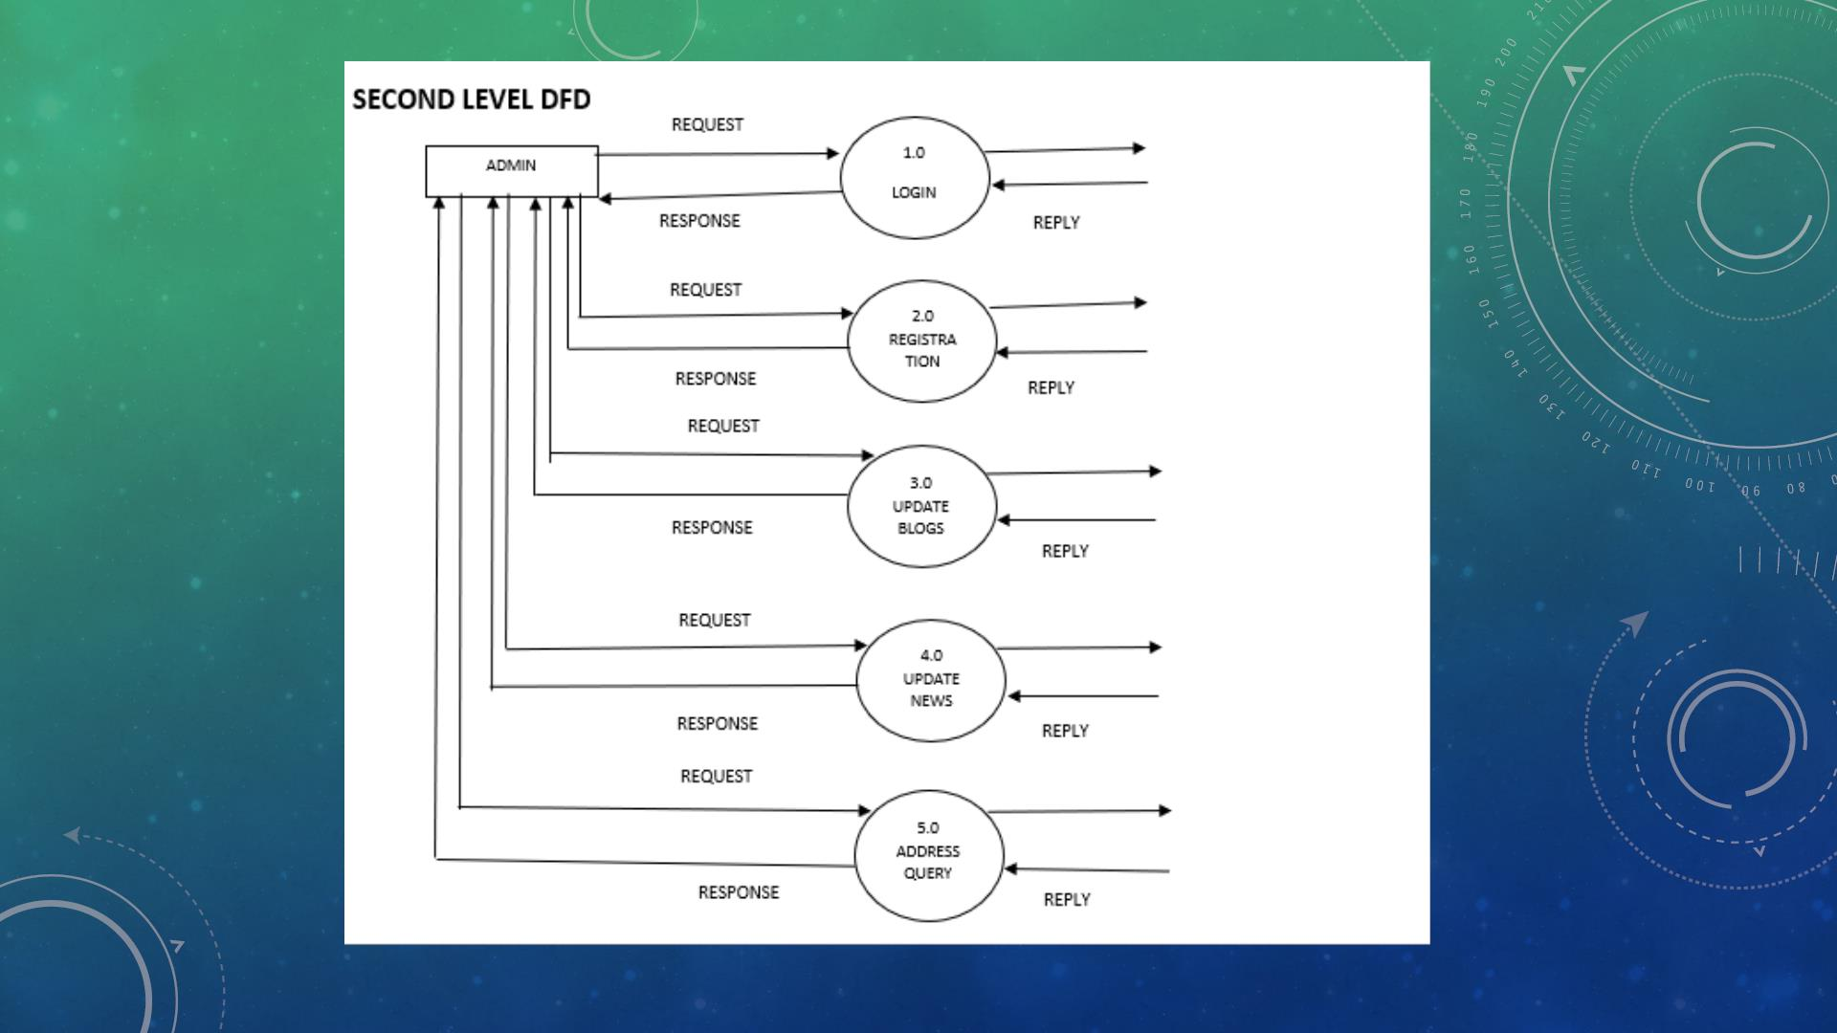

Slide 15
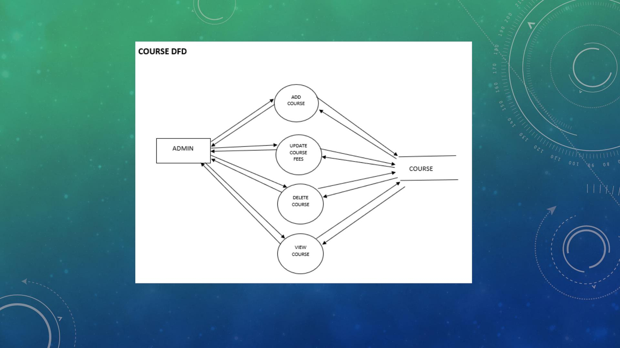

Slide 16


Slide 17
SCREENSHOTS

Slide 18
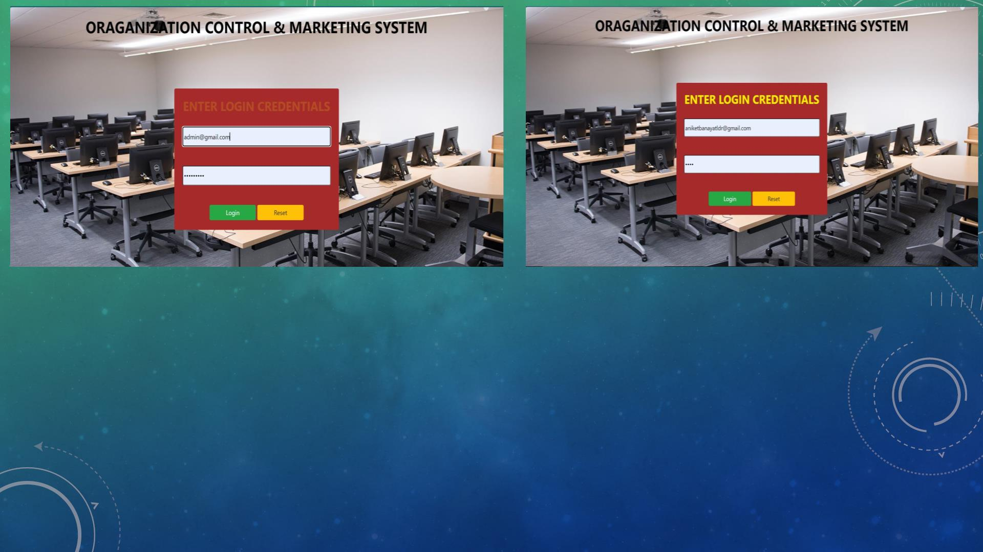

Slide 19
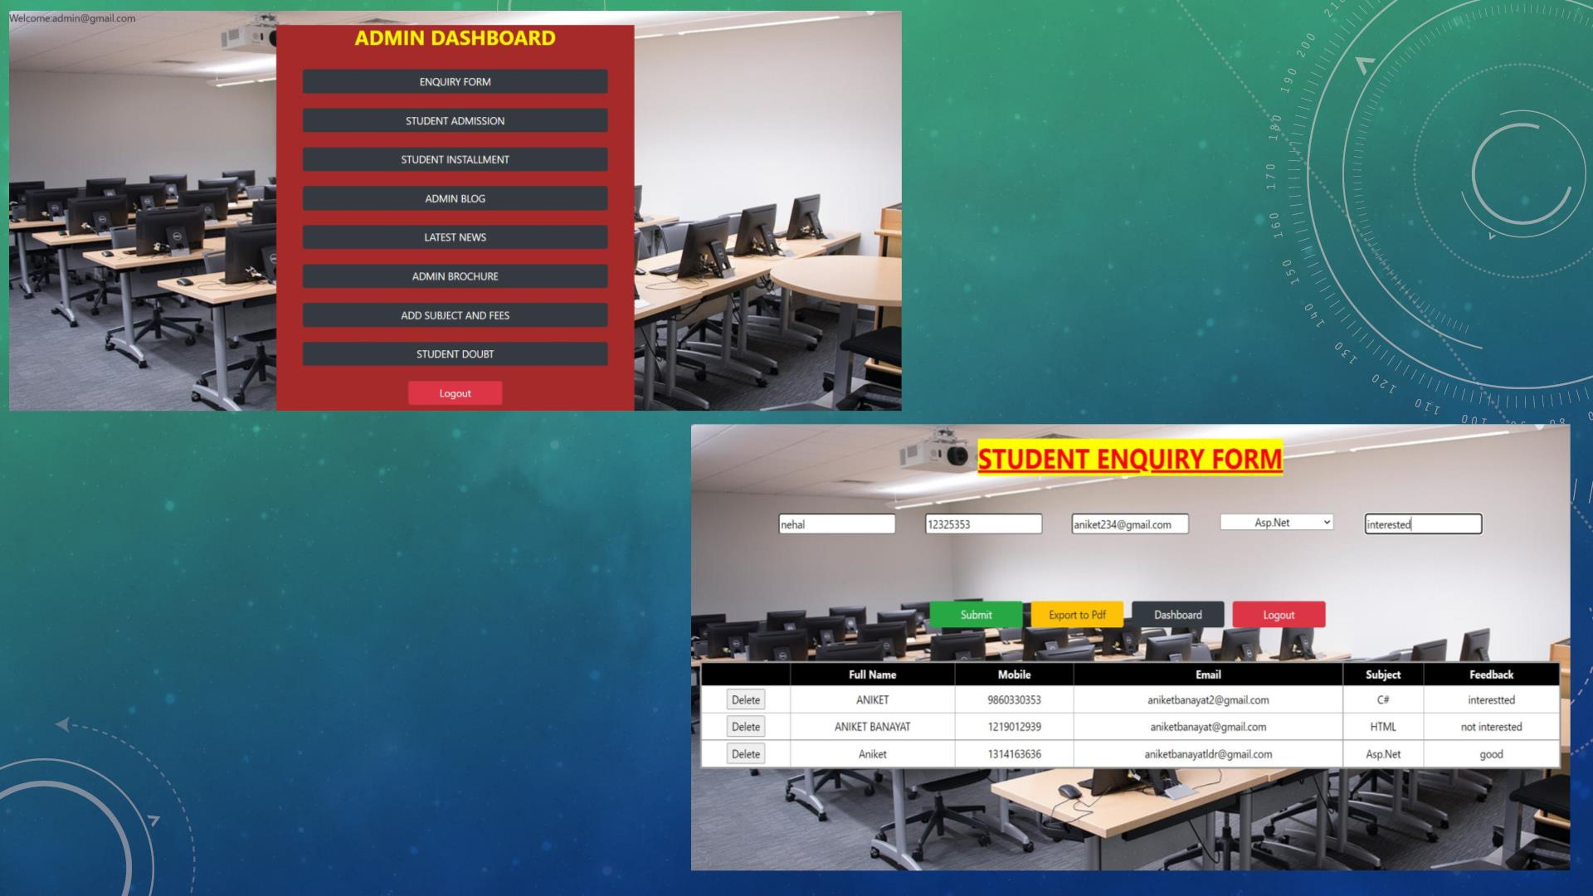

Slide 20
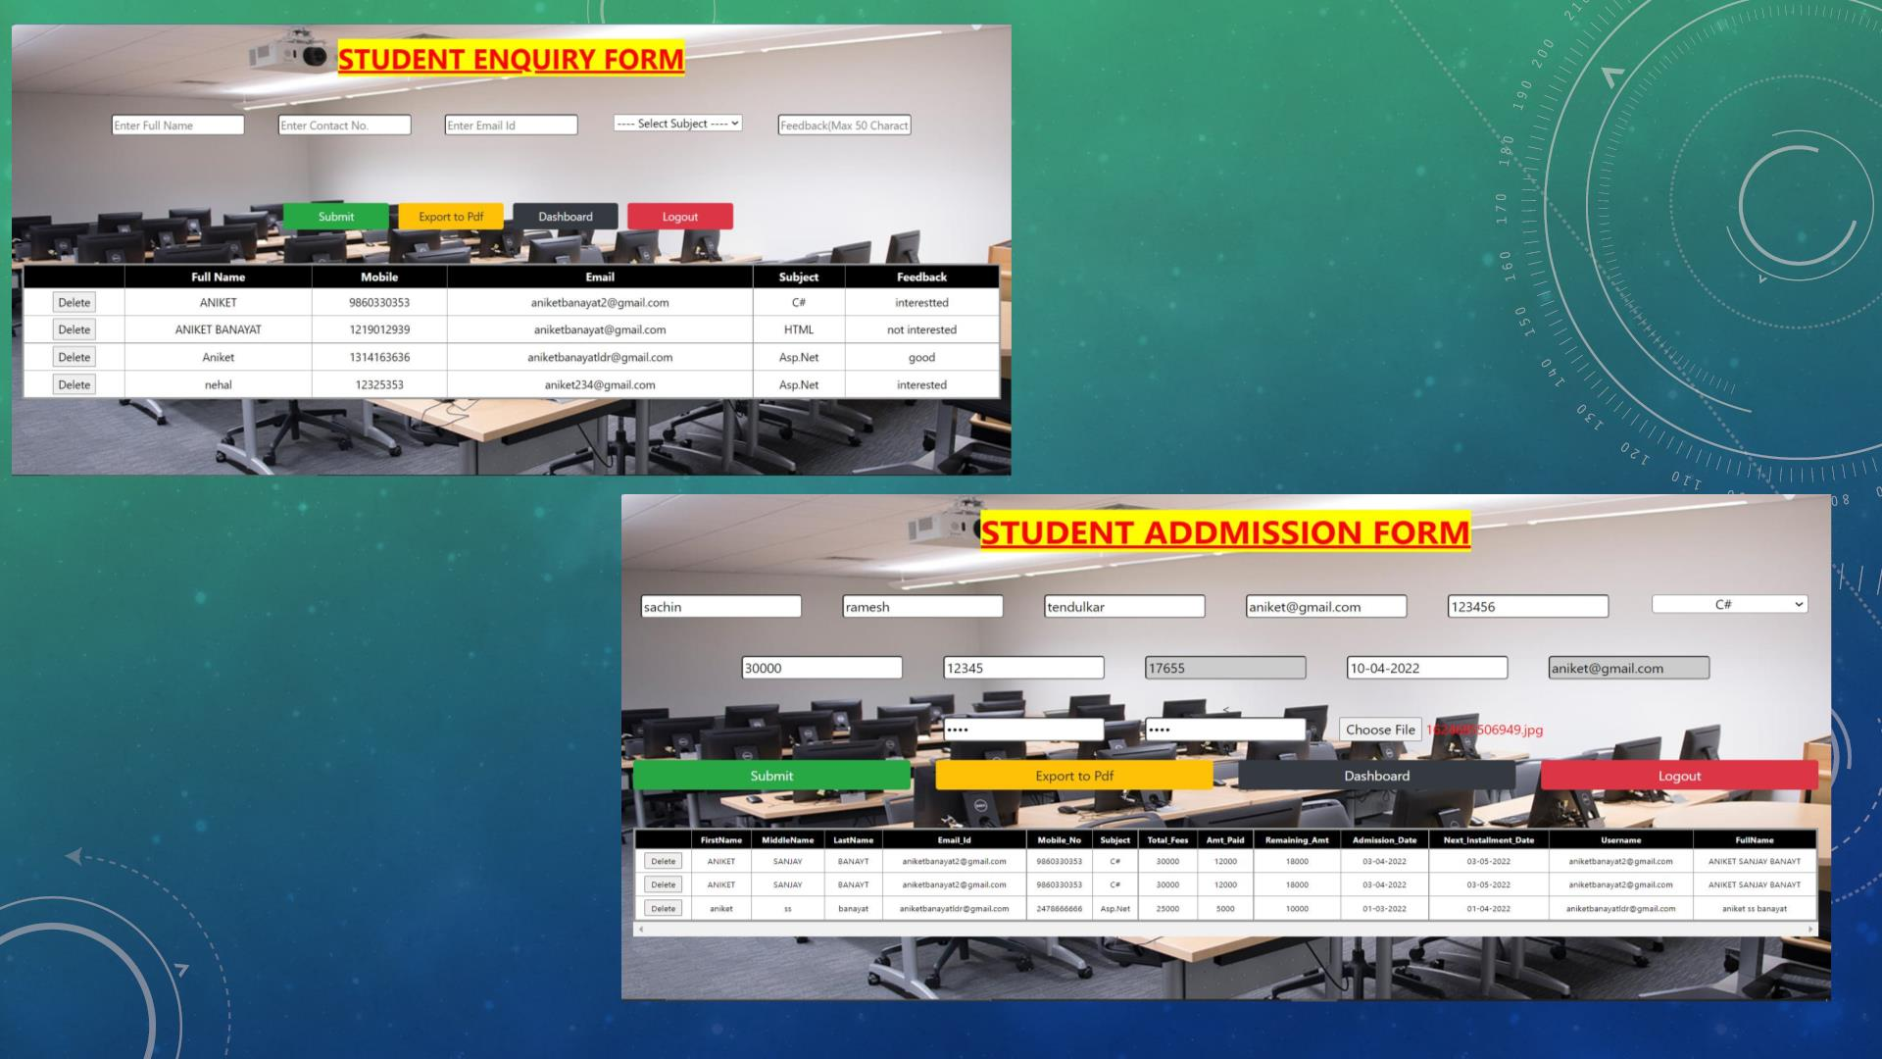

Slide 21
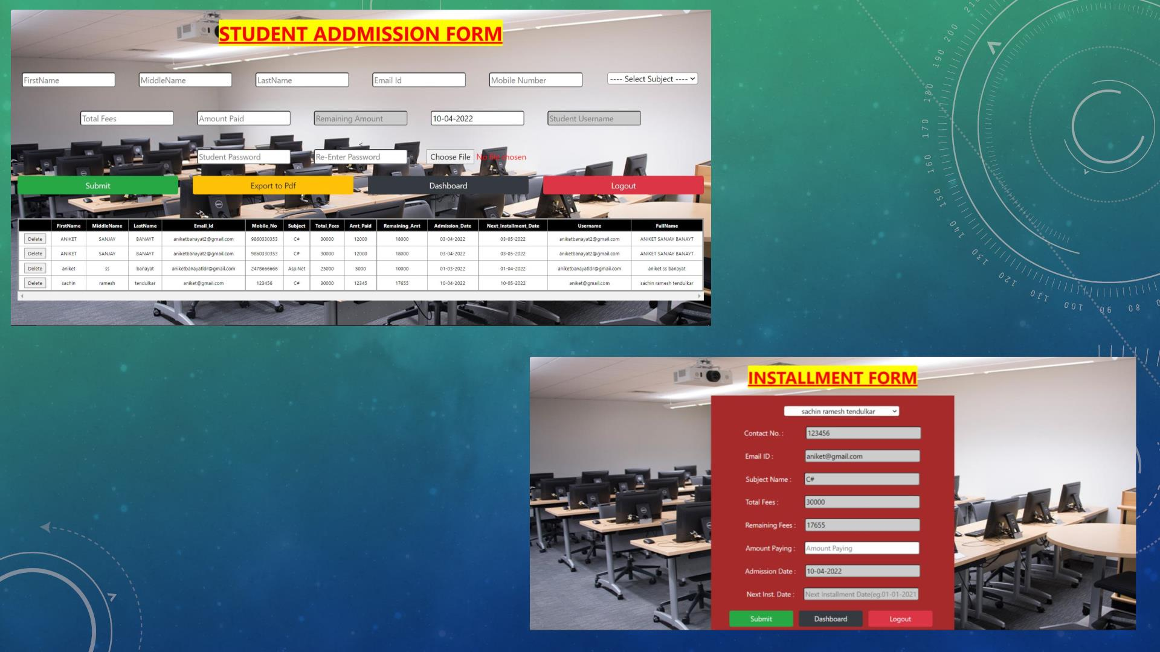

Slide 22
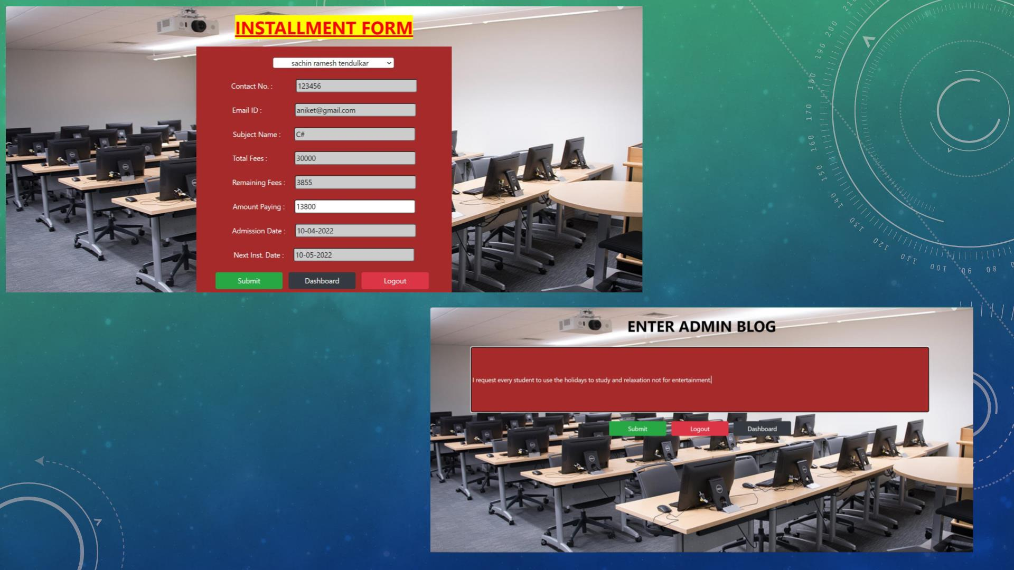

Slide 23
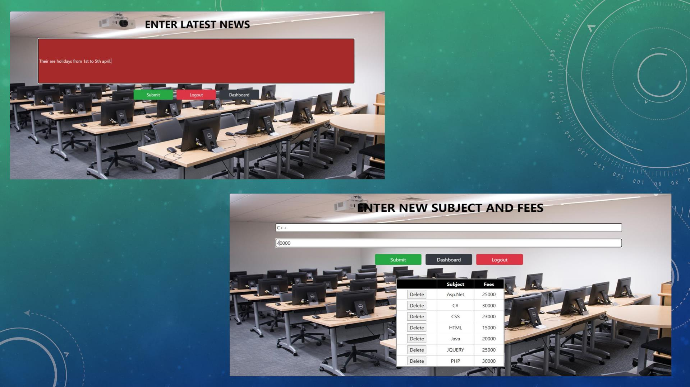

Slide 24
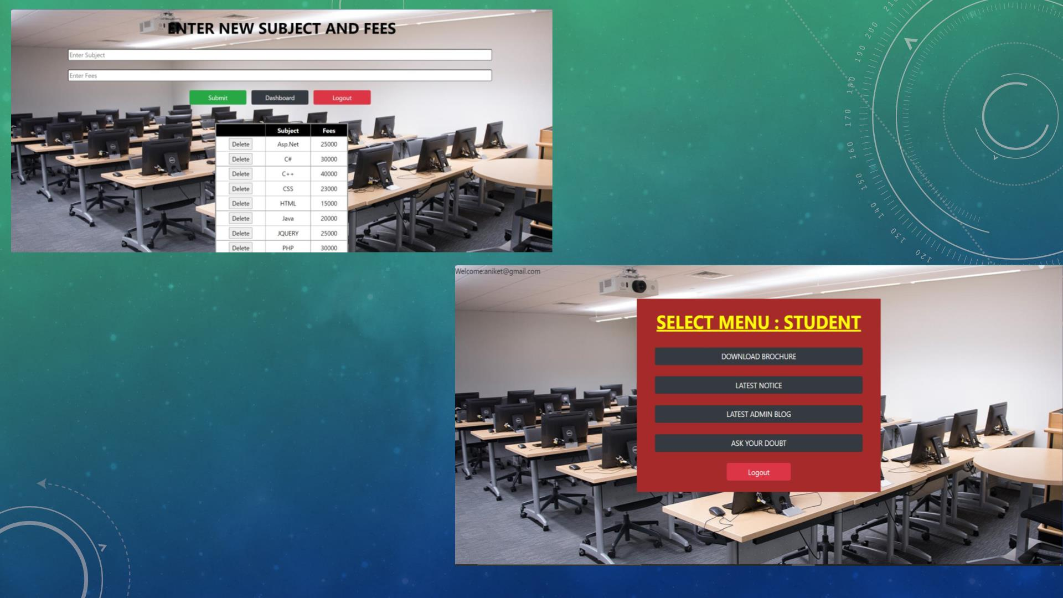

Slide 25
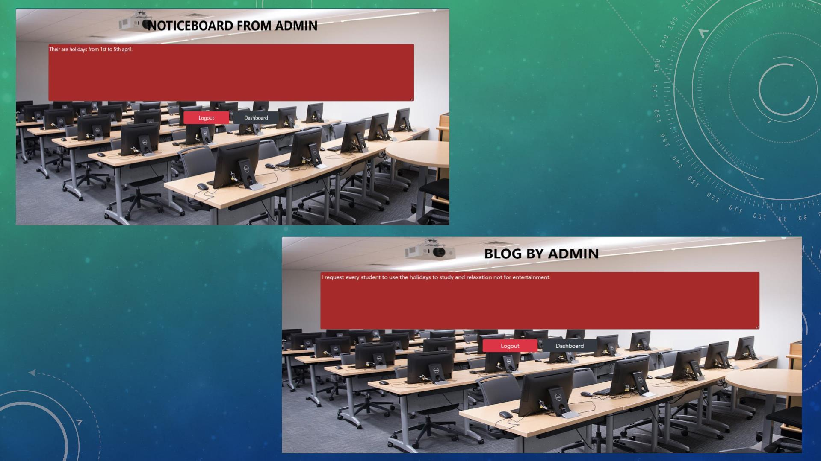

Slide 26
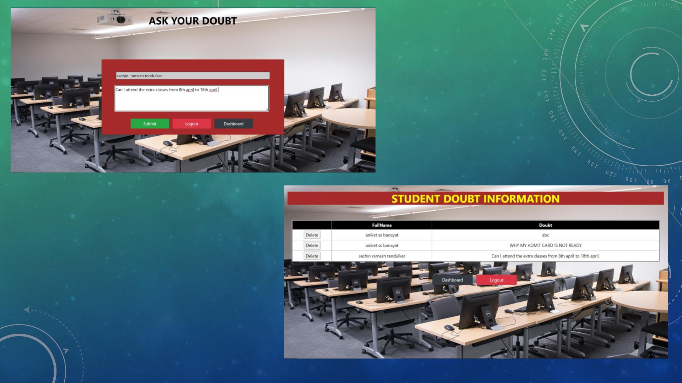

Slide 27

SPECIFICATIONS
• The application will use JavaScript, jQuery and CSS as main web technologies. HTTP and FTP protocols
are used as communication protocols. FTP is used to upload the web application in live domain and the
client can access it via HTTP protocol. SMTP protocol is used for Email communication. Several types of
validations make this web application a secured one and SQL Injections can also be prevented. Since
Student’s Online Portal is a web-based application, internet connection must be established. The
Student’s Online Portal will be used on PCs and will function via internet or intranet in any web browser

Slide 28
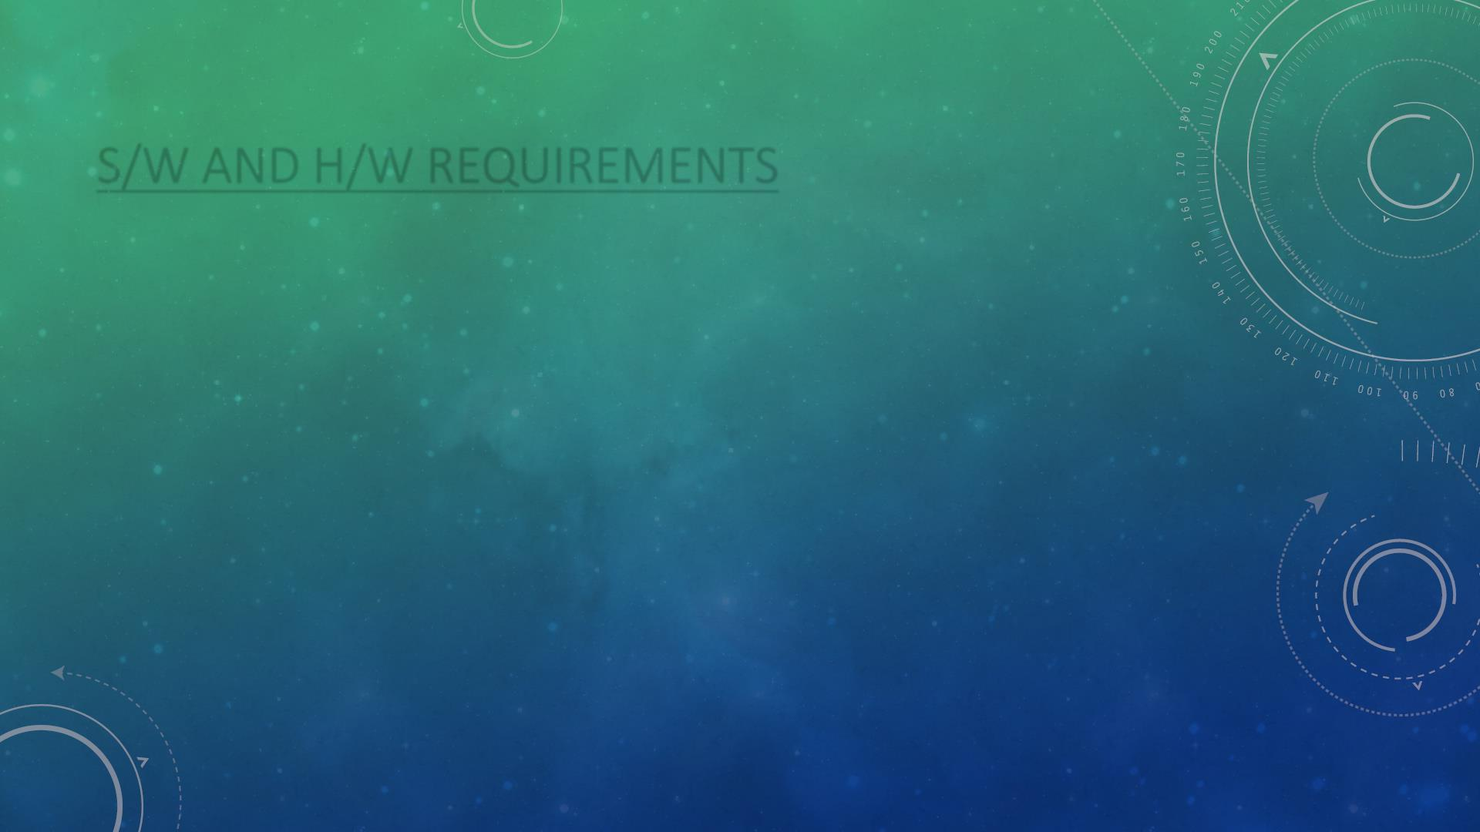
S/W AND H/W REQUIREMENTS
• Server Side:
Processor: Intel® Xeon® processor 3500 series
HDD: Minimum 500GB Disk Space
RAM: Minimum 4GB
OS: Windows 10, Linux 6
Database: MySQL
• Client Side (minimum requirement):
Processor: Intel Dual Core
HDD: Minimum 80GB Disk Space
RAM: Minimum 2GB
OS: Windows 7, Linux

Slide 29

CONCLUSION
• This project aid in automating the existing manual system. This is a paperless work. It can be monitored
and guarded remotely. It cut down the man power required and provides accurate information. All
years together huddled information can be saved and can be accessed at any time. For this reason, the
data stored in the repository helps in taking decision by management. So, it is improved to have a Web
Based system. All the stakeholders, faculty and authority can get the required information without
delay. This system is crucial in the colleges and universities.

Slide 30

FUTURE ENHANCEMENT
• This project can be enhanced further by adding payable additional courses, online feedback system,
online payment facility for the members to reduce the extra work of the admin. The software is flexible
enough to be modified and implemented as per future requirements. We have tried our Best to present
this free and user–friendly website to Institutes.

Slide 31

REFERENCES
• http://www.ijcstjournal.org/volume-7/issue-1/IJCST-V7I1P4.pdf
• https://bootstrapmade.com/mentor-free-education-bootstrap-theme/
• https://www.w3schools.com/
• https://javaee.github.io/javaee-spec/javadocs/

Slide 32

THANK YOU

